Slide 1
Vehicle
LiDAR
Rigid Link
Scan Beam
Ground Terrain
Incorrect
Correspondence
Correct
Correspondence

Slide 2
Vehicle
LiDAR
Rigid Link
Scan Beam
Ground Terrain
Incorrect
Correspondence
Correct
Correspondence

Slide 4
Odometry Outputs
Precise Odometry
Keyframe Accumulation
Transformed Scan
Scan-to-Submap
Alignment
Locomotion Prediction
Coarse Odometry
Transform
Fusion
Translation Estimation
Rotation Estimation
Factor Graph Optimization
Scan Rectification
Feature Extraction
Forward Location Adjustment
Voxelization Matching
Map Outputs
LiDAR Inputs
LiDAR Odometry
Mapping
Distorted Scan

Slide 5
System Overview
Precise Odometry
Odometry Outputs
Coarse Odometry
Transformed Scan
Scan Accumulation
Locomotion Prediction
Transform
Fusion
Translation Estimation
Rotation Estimation
LiDAR Inputs
Points
Undistortion
Feature Extraction
Inlier Graph
Construction
Inlier
Selection
Scan-to-Submap
Optimization
LiDAR Odometry
Mapping
Distorted Scan

Slide 6
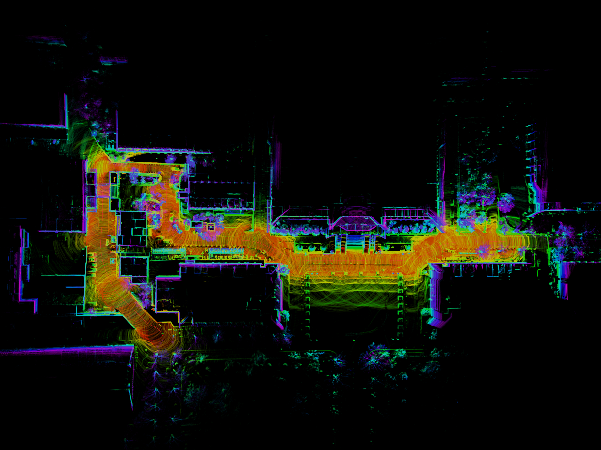
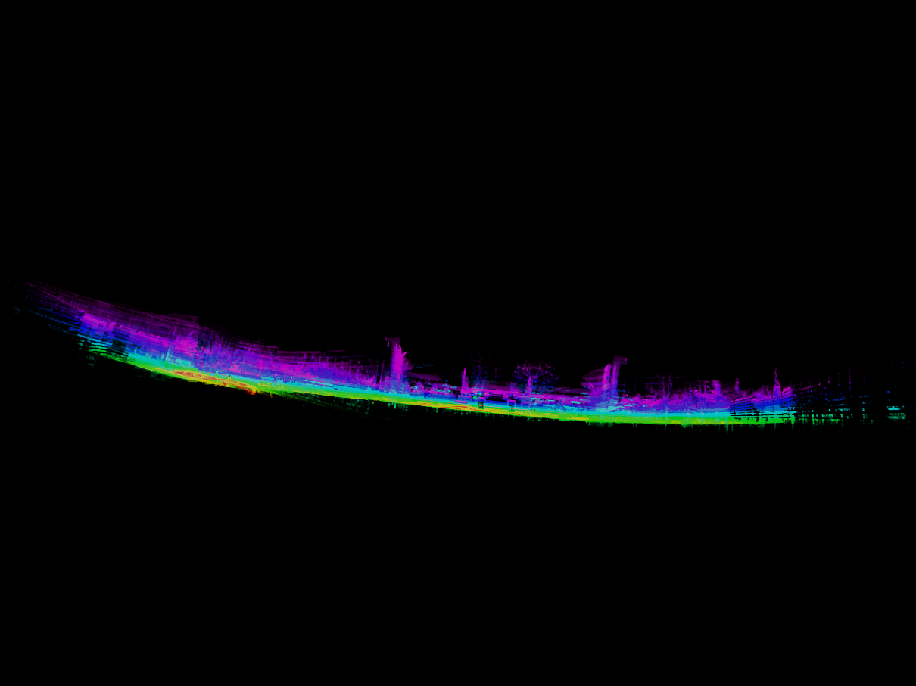
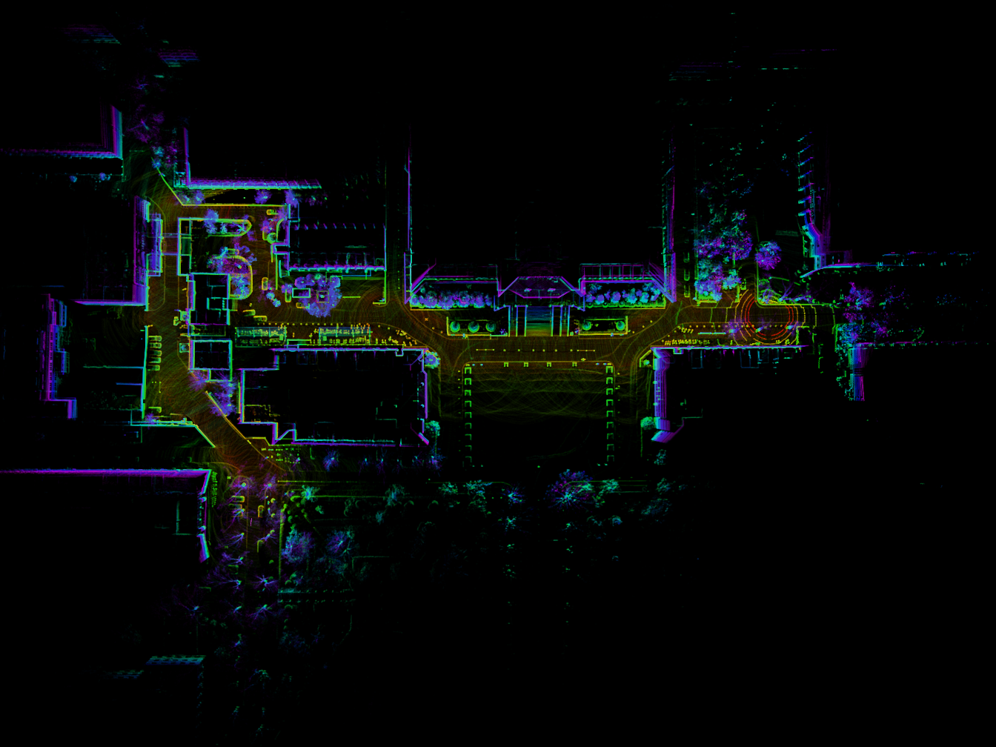
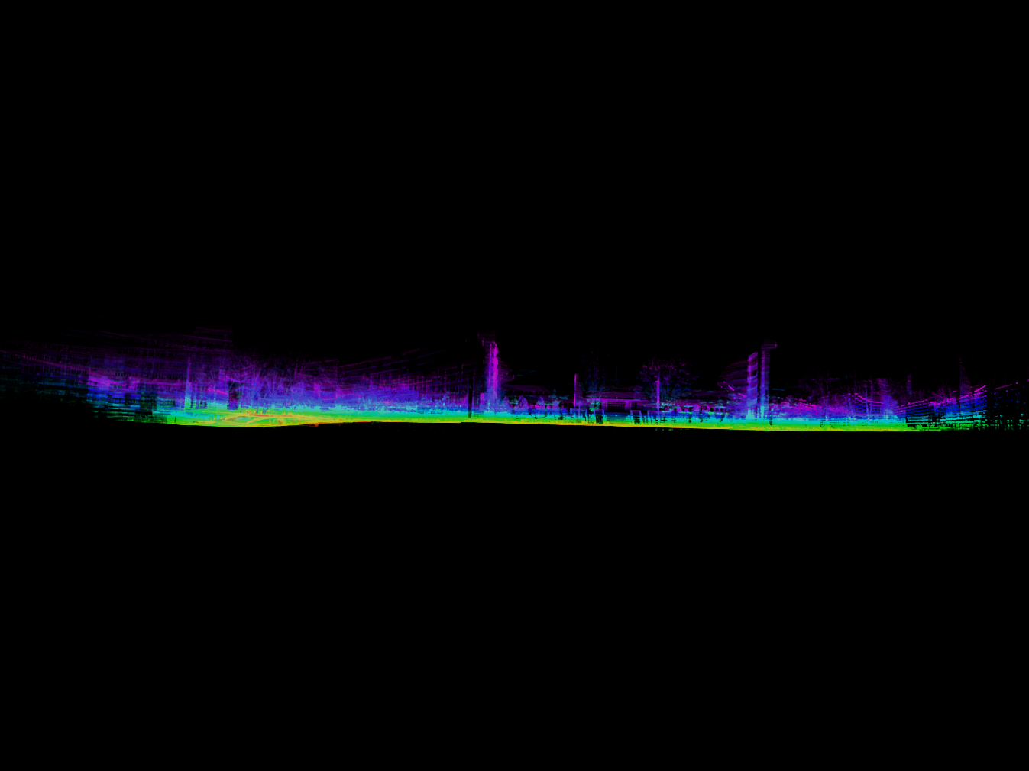
(a)
(b)

Slide 7
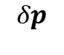
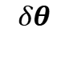
y
Driving Direction
y
Driving Direction
ZOOM
$$δθ$$
$$δp$$
O
x
O
x

Slide 8
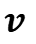
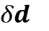
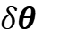
z
Driving Direction
$$v$$
$$δθ_{}$$
$$δd_{}$$
O
x

Slide 9

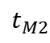
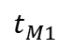
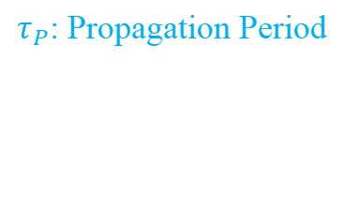
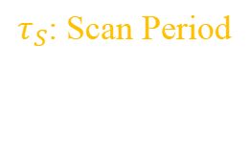
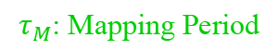
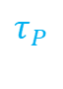

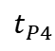
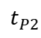
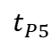
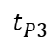
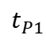
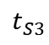
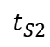
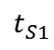
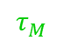
(a)
$$τ_{M}$$
$$t_{M1}$$
$$τ_{S}$$
$$t_{M2}$$
$$⋯$$
(b)
$$t_{S1}$$
$$t_{S2}$$
$$t_{S3}$$
$$⋯$$
(c)
$$τ_{P}$$
$$t_{P1}$$
$$t_{P2}$$
$$t_{P3}$$
$$t_{P4}$$
$$t_{P5}$$
$$⋯$$
$τ_{M}$: Mapping Period
$τ_{S}$: Scan Period
$τ_{P}$: Propagation Period

Slide 10
Alignment Direction
Multi-layer
Sphere
LiDAR
Target Point
Source Point

Slide 11
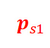
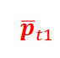
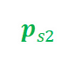
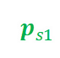
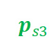
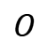
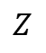
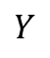
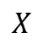
$$Z$$
$${\overline{p}}_{t1}$$
$$p_{s2}$$
$$p_{s1}$$
$${\overline{p}}_{t1}$$
$$X$$
$$O$$
$$Y$$
$$p_{s3}$$
$${\overline{p}}_{t1}$$
LiDAR
Target Point
$$p_{s1}$$
Source Point
Multi-layer
Sphere

Slide 12

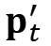
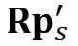

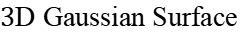
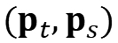

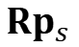
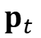
$3$D Gaussian Surface
$$p_{t}^{′}$$
$$p_{t}$$
$$d_{i}$$
$${Rp}_{s}$$
$${Rp}_{s}^{′}$$
$$O$$
$$(p_{t},p_{s})$$

Slide 13


$3$D Gaussian Surface
$$p_{t}^{′}$$
$$p_{t}$$
$$d_{i}$$
$$∟$$
$${Rp}_{s}$$
$$O$$
$$(p_{t},p_{s})$$

Slide 14



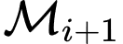


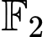
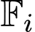
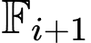
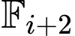
$$x_{0}$$
$$x_{1}$$
$$x_{2}$$
$$x_{i}$$
$$x_{i+1}$$
$$x_{i+2}$$
Node
State
Keyframe
LiDAR frame
Landmark
Submap
Scan-to-submap
Scan registration
Odometry factor
Loop-closure factor

Slide 15
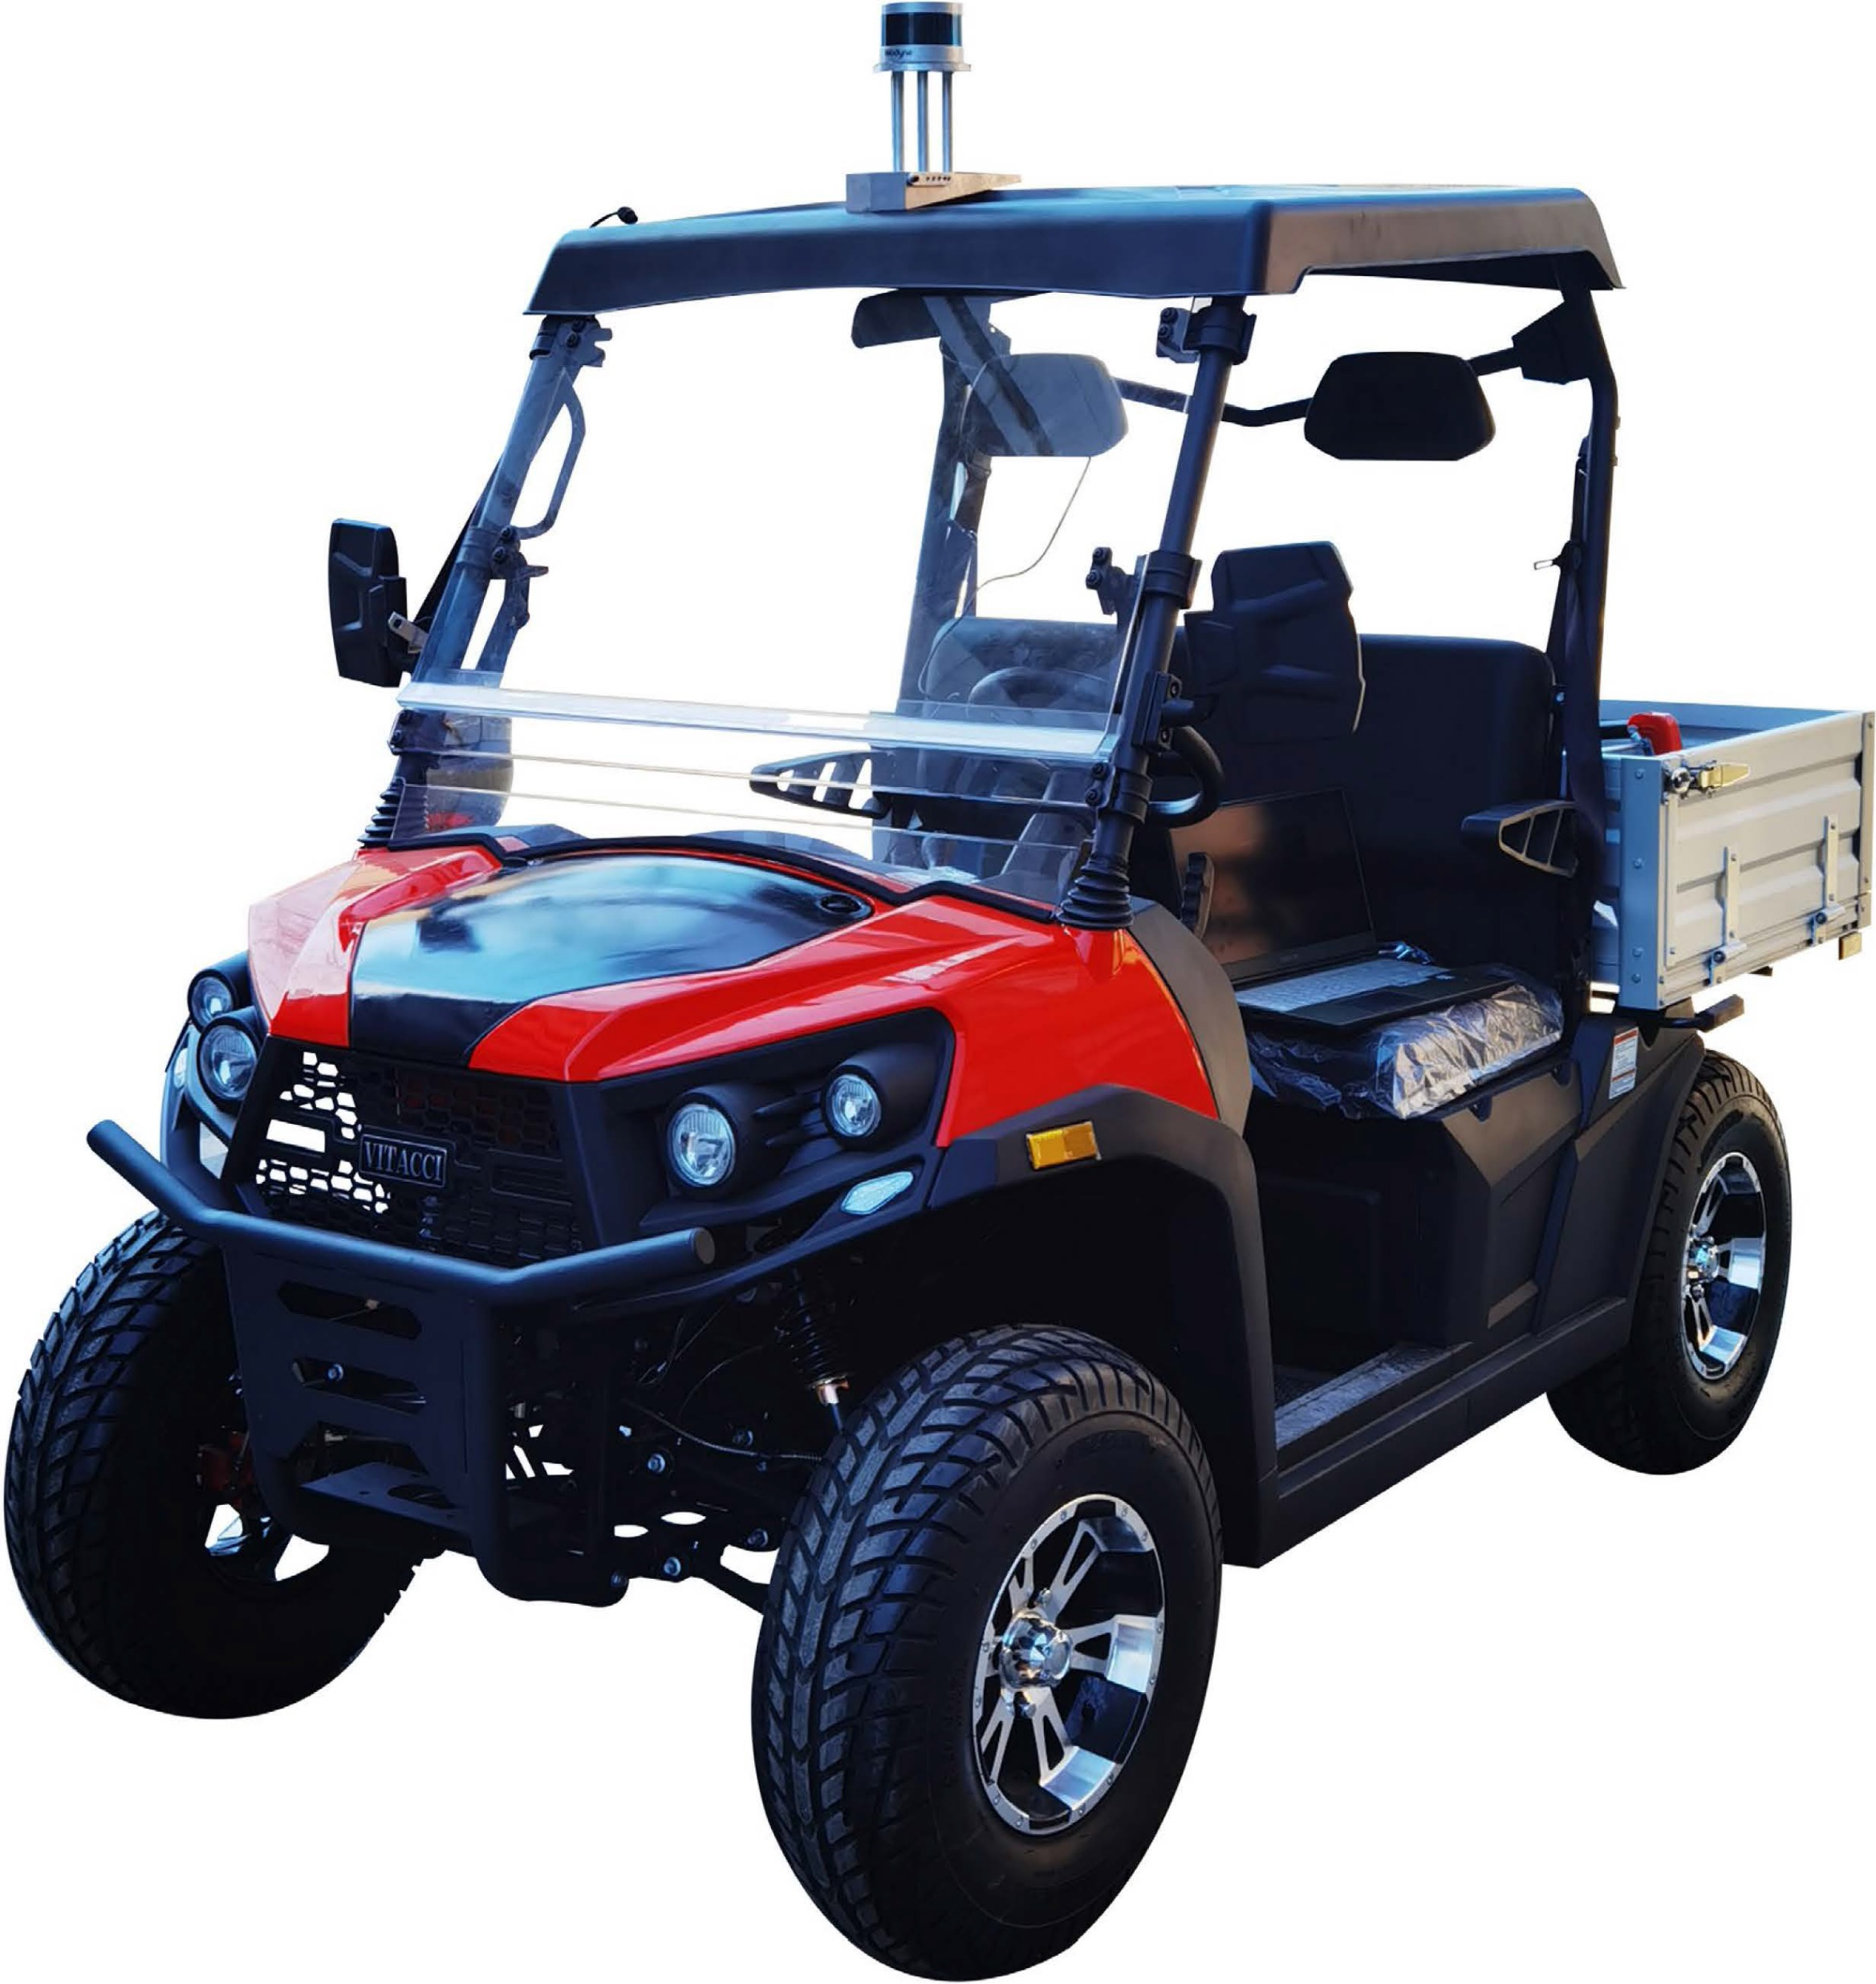
LiDAR
GPS
9-axis IMU

Slide 16
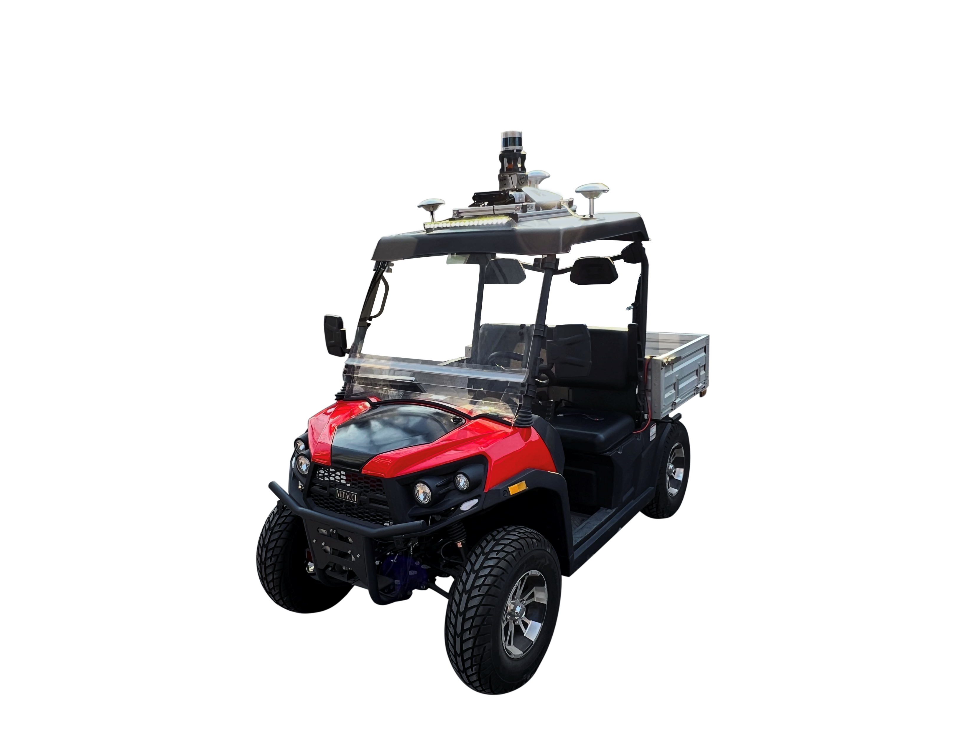
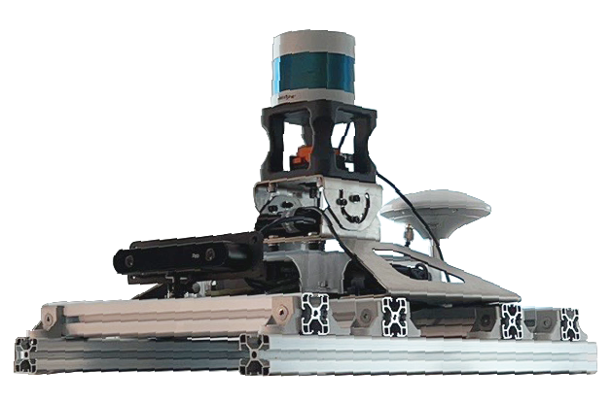
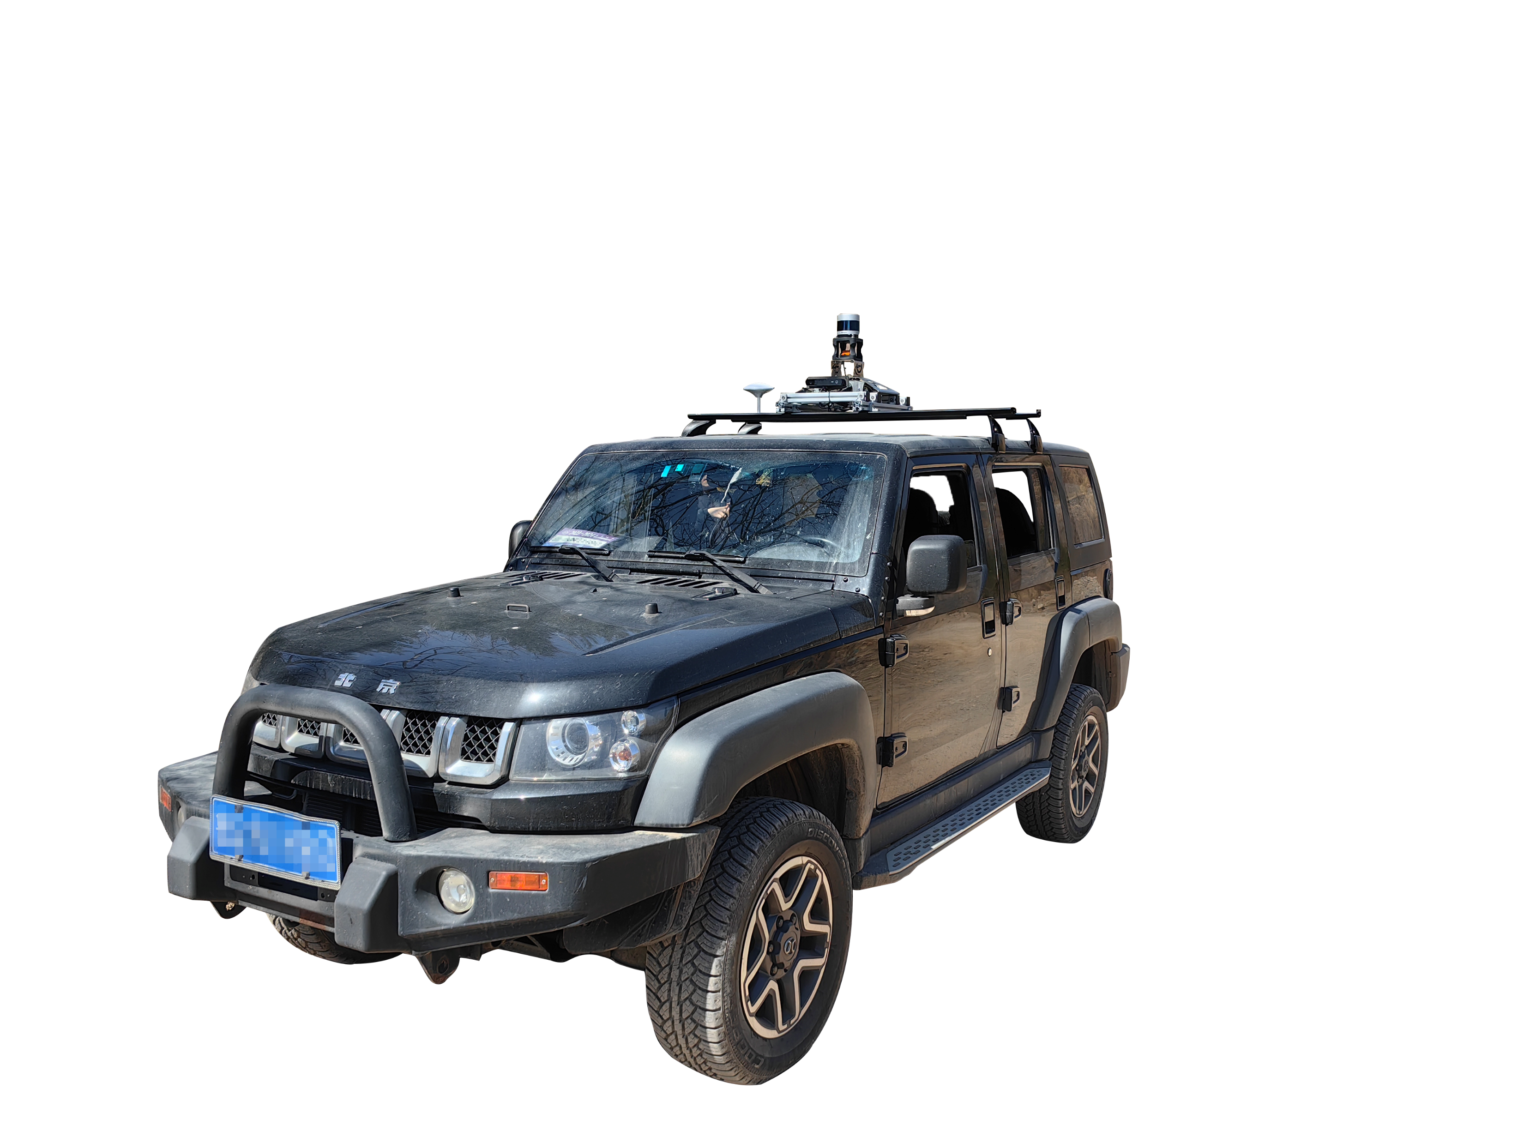
VLP 32C Puck
ZED2i Camera
Xsense Mti-300
GW-GNS100
(a) Sensing Platform
(b) Ground Vehicle Platform

Slide 17
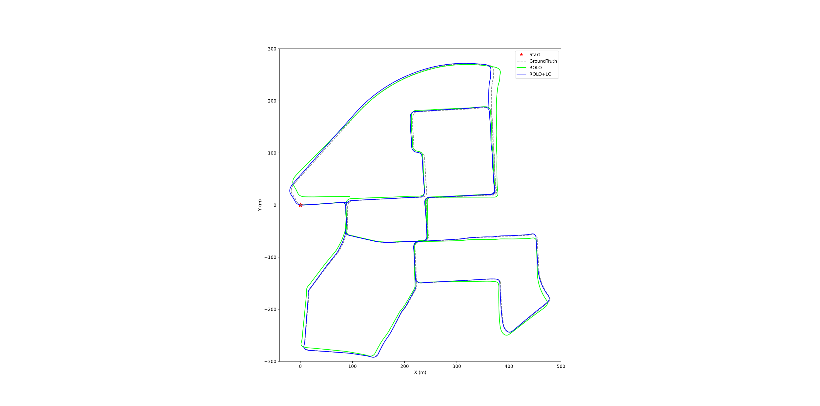
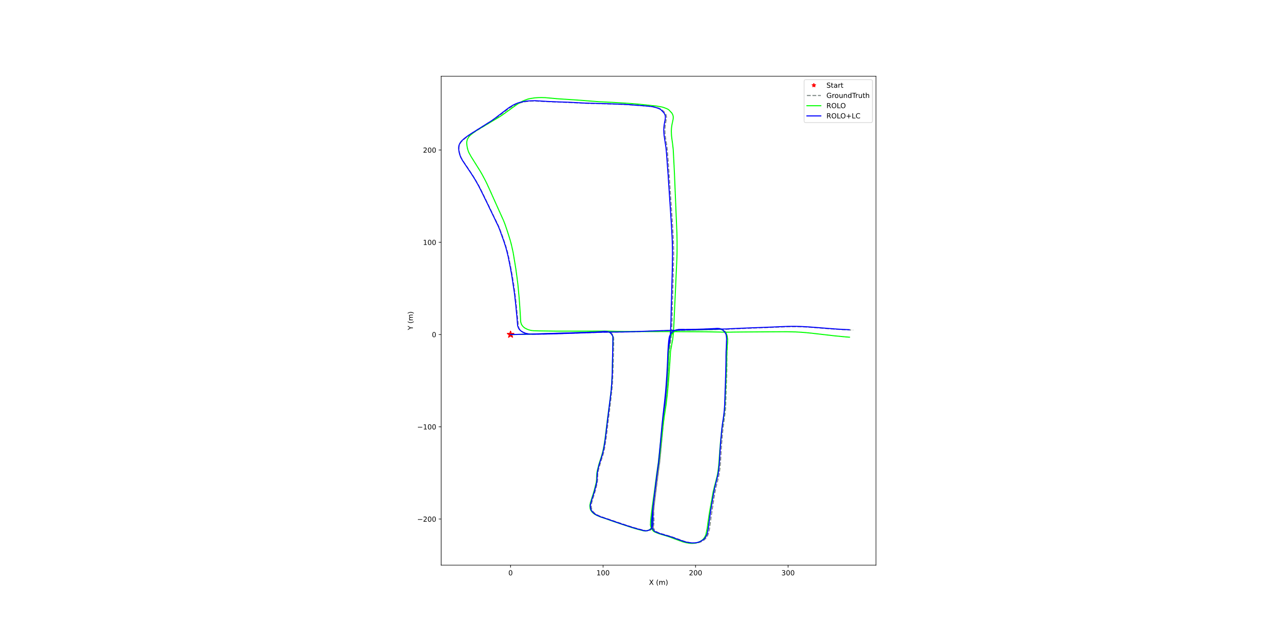




(a)
(c)
(e)
(b)
(d)
(f)

Slide 18




(a)
(c)
(b)
(d)

Slide 19




(a)
(c)
(b)
(d)

Slide 20








(a) KITTI 00
(b) KITTI 05
(c) KITTI 08
(d) Offroad1
(e) Offroad2
(f) Offroad3
(g) Qianfoshan
(h) Xinglongshan

Slide 21








(a) KITTI 00
(b) KITTI 05
(c) KITTI 08
(d) Offroad1
(e) Offroad2
(f) Offroad3
(g) Qianfoshan
(h) Xinglongshan

Slide 22







(a) Google Map
(b) HDL-LOAM
(c) LeGO-LOAM
(d) ROLO

Slide 23



430m
785m
End
Start
(a)
(b)
(c)

Slide 24







3
2
1

Slide 25
3
2
1

Slide 26
3
3
2
2
2
3
1
1
1

Slide 27
3
2
1

Slide 28




(a)
(b)
(c)
(d)

Slide 29


Offroad1
End
Start
Offroad2

Slide 30

(a)
End
Start
(b)

